Slide 1
Secure Coding
420-E31 Systems III
References:
https://www.securecoding.cert.org/confluence/display/seccode/Top+10+Secure+Coding+Practices
https://developer.apple.com/library/mac/documentation/security/conceptual/securecodingguide/Introduction.html#//apple_ref/doc/uid/TP40002477-SW1
https://www.owasp.org/images/0/08/OWASP_SCP_Quick_Reference_Guide_v2.pdf

Slide 2
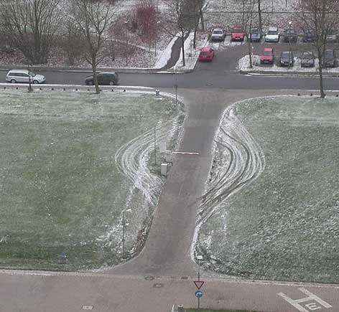
Security: Circumvent vs Defeat
Notes:
This photograph illustrates how the easiest way to break system security is often to circumvent it rather than defeat it (as is the case with most software vulnerabilities related to insecure coding practices).
https://www.securecoding.cert.org/confluence/display/seccode/Top+10+Secure+Coding+Practices

Slide 3
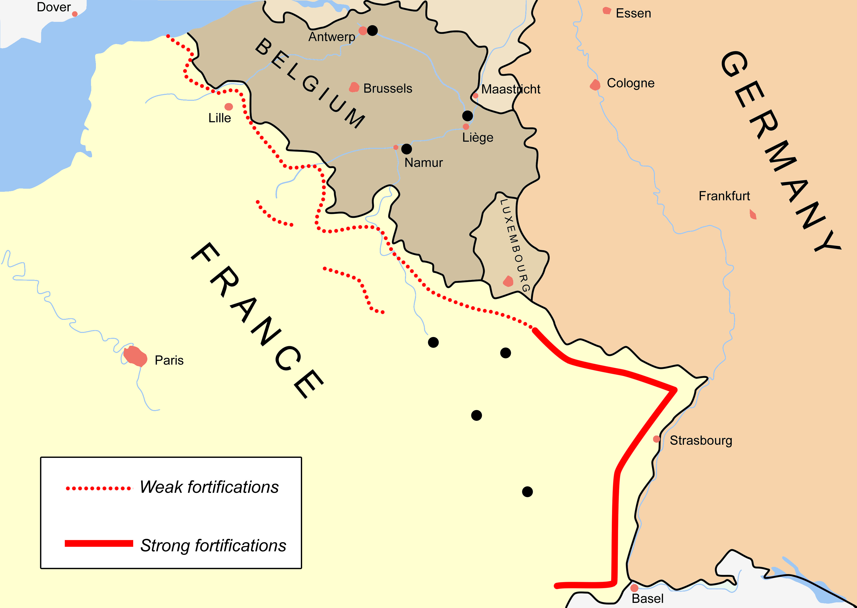
Security: Circumvent vs Defeat
Notes:
Between WWI and WWII, the French invested in making the Maginot line.
Considered impervious to most forms of attack, including tank and aerial….
WWII: Germany invaded France through Belgium. France fell in 6 weeks.
Because of its place in history, the Maginot line has come to mean "a defensive barrier or strategy that inspires a false sense of security," according to Merriam-Webster.

Slide 4
It Could be Your Code…
Every software program is a potential target.
Attackers will try to find security vulnerabilities in your applications or servers.

Slide 5
From the Beginning
Security is not something that can be added to software as an afterthought.
You must identify the nature of the threats to your software and incorporate secure coding practices throughout the planning and development of your product.
Notes:
Just as a shed made out of cardboard cannot be made secure by adding a padlock to the door, an insecure tool or application may require extensive redesign to secure it.

Slide 6
SDLC
Software security flaws can be introduced at any stage of the software development lifecycle, including:
Not identifying security requirements up front
Creating conceptual designs that have logic errors
Using poor coding practices that introduce technical vulnerabilities
Deploying the software improperly
Introducing flaws during maintenance or updating

Slide 7
What is Secure Coding?
The practice of writing programs that are resistant to attack by malicious or mischievous people or programs.
Helps protect a user’s data from theft or corruption.

Slide 8
Why Secure Coding?
An insecure program can provide access for an attacker to take control of a server or user’s computer, resulting in anything from:
  a denial of service attack
  compromise of secrets
  loss of service
  damage to the systems of large numbers of users.

Slide 9
Web Application Attacks
A 2009 SANS study found that attacks against web applications constitute more than 60% of the total attack attempts observed on the Internet
Notes:
https://www.owasp.org/images/0/08/OWASP_SCP_Quick_Reference_Guide_v2.pdf

Slide 10
Secure Coding Practices
Validate input
Heed compiler warnings
Architect and design for security policies
Keep it simple
Default deny
Adhere to the principle of least privilege
Sanitize data sent to other systems
Practice defence in depth
Use effective testing techniques
Adopt a secure coding standard
Notes:
Source: https://www.securecoding.cert.org/confluence/display/seccode/Top+10+Secure+Coding+Practices

Slide 11
Practice 1: Validate Input
Validate input from all untrusted data sources.
Proper input validation can eliminate the vast majority of software vulnerabilities.
Be suspicious of most external data sources.

Slide 12
Practice 2: Heed Compiler Warnings
Compile code using the highest warning level available for your compiler and eliminate warnings by modifying the code.
Use static and dynamic analysis tools to detect and eliminate additional security flaws.

Slide 13
Practice 3: Design in Security
Architect and design for security policies
Create a software architecture and design your software to implement and enforce security policies.
  If system requires different privileges at different times, consider dividing the system into distinct intercommunicating subsystems, each with an appropriate privilege set.

Slide 14
Practice 4: KISS
Keep it simple stupid
Keep the design as simple and small as possible.
Complex designs increase the likelihood that errors will be made in their implementation, configuration, and use.

Slide 15
Practice 5: Default Deny
Base access decisions on permission rather than exclusion.
This means that, by default, access is denied and the protection scheme identifies conditions under which access is permitted.

Slide 16
Practice 6: Least Privilege
Adhere to the principle of least privilege.
Every process should execute with the least set of privileges necessary to complete the job.
Any elevated permission should be held for a minimum time.
This approach reduces the opportunities an attacker has to execute arbitrary code with elevated privileges.

Slide 17
Practice 7: Sanitize Data
Sanitize data sent to other systems.
Sanitize all data passed to complex subsystems such as command shells, relational databases, and commercial off-the-shelf (COTS) components.
Attackers may be able to invoke unused functionality in these components through the use of SQL, command, or other injection attacks.
Notes:
This is not necessarily an input validation problem because the complex subsystem being invoked does not understand the context in which the call is made. Because the calling process understands the context, it is responsible for sanitizing the data before invoking the subsystem.

Slide 18
Practice 8: Practice Defence
Practice defense in depth.
Manage risk with multiple defensive strategies, so that if one layer of defense turns out to be inadequate, another layer of defense can prevent a security flaw from becoming an exploitable vulnerability and/or limit the consequences of a successful exploit.
Notes:
For example, combining secure programming techniques with secure runtime environments should reduce the likelihood that vulnerabilities remaining in the code at deployment time can be exploited in the operational environment

Slide 19
Practice 9: Test
Use effective quality assurance techniques.
Good quality assurance techniques can be effective in identifying and eliminating vulnerabilities.
  Fuzz testing, penetration testing, and source code audits should all be incorporated as part of an effective quality assurance program.
  Independent security reviews can lead to more secure systems.
  External reviewers bring an independent perspective.

Slide 20
Practice 9: Test
Fuzzing, or fuzz testing, is the technique of randomly or selectively altering otherwise valid data and passing it to a program to see what happens.
If the program crashes or otherwise misbehaves, that’s an indication of a potential vulnerability that might be exploitable.
Fuzzing is a favorite tool of hackers who are looking for buffer overflows.

Slide 21
Practice 10: Secure Coding Standard
Adopt a secure coding standard.
Develop and/or apply a secure coding standard for your target development language and platform.

Slide 22
Practice 11: Requirements
Define security requirements.
Identify and document security requirements early in the development life cycle.
  Make sure that subsequent development artifacts are evaluated for compliance with those requirements.
When security requirements are not defined, the security of the resulting system cannot be effectively evaluated.

Slide 23
Types of Security Vulnerabilities
Most software security vulnerabilities fall into one of a small set of categories:
  buffer overflows
  unvalidated input
  race conditions
  access-control problems
  weaknesses in authentication, authorization, or cryptographic practices

Slide 24
Buffer Overflows
A buffer overflow occurs when an application attempts to write data past the end (or, occasionally, past the beginning) of a buffer.
When the input data is longer than will fit in the reserved space, if you do not truncate it, that data will overwrite other data in memory. When this happens, it is called a buffer overflow.

Slide 25
Buffer Overflows
Any software that takes input from the user, from a file, or from the network has to store that input, at least temporarily. Most application memory is stored in one of two places:
  stack—A part of an application’s address space that stores data that is specific to a single call to a particular function, method, block, or other equivalent construct.
  heap—General purpose storage for an application. Data stored in the heap remains available as long as the application is running

Slide 26
Buffer Overflows
Class instances, data allocated with malloc, core foundation objects, and most other application data resides on the heap.
Buffer overflow attacks generally occur by compromising either the stack, the heap, or both.

Slide 27
Buffer Overflow Examples
For example, if your program asks for a filename, you should attempt to enter a string longer than the maximum legal filename.
Or, if there is a field that specifies the size of a block of data, attempt to use a data block larger than the one you indicated in the size field.

Slide 28
Unvalidated Input
As a general rule, you should check all input received by your program to make sure that the data is reasonable.

Slide 29
Unvalidated Input
Hackers look at every source of input to the program and attempt to pass in malformed data of every type they can imagine.
If the program crashes or otherwise misbehaves, the hacker then tries to find a way to exploit the problem.
  Unvalidated-input exploits have been used to take control of operating systems, steal data, corrupt users’ disks, and more.
  One such exploit was even used to “jail break” iPhones.

Slide 30
Unvalidated Input
There are a number of ways an attacker can take advantage of unvalidated input:
  Buffer overflows
  Format string vulnerabilities
  URL commands
  Code insertion
  Social engineering

Slide 31
Input Validation Checklist
There should be a centralized input validation routine for the app
Encode data to a common character set before validating
All validation failures should result in input rejection
Validate all client provided data before processing, including all parameters, URLs and HTTP header content (e.g. Cookie names and values).
  Be sure to include automated post backs from JavaScript, Flash or other embedded code
Verify that header values in both requests and responses contain only ASCII characters

Slide 32
Input Validation Checklist
Validate data from redirects (An attacker may submit malicious content directly to the target of the redirect, thus circumventing application logic and any validation performed before the redirect)
Validate for expected data types
Validate data range
Validate data length
Validate all input against a "white" list of allowed characters, whenever possible

Slide 33
Race Conditions
A race condition exists when changes to the order of two or more events can cause a change in behaviour.
If the correct order of execution is required for the proper functioning of the program, this is a bug.
If an attacker can take advantage of the situation to insert malicious code, change a filename, or otherwise interfere with the normal operation of the program, the race condition is a security vulnerability.
Notes:
Attackers can sometimes take advantage of small time gaps in the processing of code to interfere with the sequence of operations, which they then exploit.

Slide 34
Race Condition Example
If you open a file and then read from it, even though your application did nothing else between these two operations, some other process might alter the file after the file was opened and before it was read.
If two different processes were writing to the same file, there would be no way to know which one would write first and which would overwrite the data written by the other.
Such situations cause security vulnerabilities.

Slide 35
Interprocess Communication
Separate processes have to share information.
Common methods include using shared memory or using sockets.
These messaging protocols used for interprocess communication are often vulnerable to attack.
  You must always assume that the process at the other end of your communication channel could be hostile.

Slide 36
Insecure File Operations
In addition to time-of-check–time-of-use problems, many other file operations are insecure.
Programmers often make assumptions about the ownership, location, or attributes of a file that might not be true.

Slide 37
Time-of-check–time-of-use Problem
An application might check to see if a file exists before writing to it, or whether the user has access rights to read a file before opening it for reading.
Because there is a time gap between the check and the use (even though it might be a fraction of a second), an attacker can sometimes use that gap to mount an attack.
  Solution -> Use a locking mechanism

Slide 38
Insecure File Operation Best Practices
Don’t read/write files in a publicly writable directory.
If possible, create a subdirectory with tightly controlled permissions, then write your files inside that subdirectory.

Slide 39
Insecure File Operation Best Practices
If you must work in a directory to which your process does not have exclusive access:
  Check to make sure a file does not exist before you create it.
  Verify that the file you intend to read from or write to is the same file that you created.
Use routines that operate on file descriptors rather than pathnames so that you can be certain you’re always dealing with the same file.

Slide 40
Insecure File Operations
For example, you might assume that you can always write to a file created by your program.
However, if an attacker can change the permissions or flags on that file after you create it, and if you fail to check the result code after a write operation, you will not detect the fact that the file has been tampered with.
Best Practice ->Don’t read/write files in a publicly writable directory.

Slide 41
Insecure File Operation Examples
Writing to or reading from a file in a location writable by another user .
Failing to make the right checks for file type, device ID, links, etc. before using a file.
Failing to check the result code after a file operation.
Assuming that if a file has a local pathname, it has to be a local file.

Slide 42
Access Control Problems
Access control is the process of controlling who is allowed to do what.
Many security vulnerabilities are created by the careless/improper use of access controls, or by the failure to use them at all.
  Use authentication and authorization
  Assign permissions
  Digital certificates

Slide 43
Secure Storage and Encryption
Encryption can be used to protect a user’s secrets from others, either during data transmission or when the data is stored.

Slide 44
Place Files in Secure Locations
Unless you are encrypting all output, the location where you save files has important security implications.
You should restrict the locations where users can save files if they contain information that must be protected.

Slide 45
Injection Attacks
Common vulnerability in web development.
The most common type of injection attack is SQL injection, a technique that takes advantage of the syntax of SQL to inject arbitrary commands

Slide 46
Cross-Site Scripting
Another significant risk associated with web development is cross-site scripting.
Injecting code into a website that causes it to behave differently than it otherwise would.
  An attacker might inject a key logger that displays a fake login dialog and sends the passwords back to the attacker.
Notes:
https://www.owasp.org/index.php/XSS_(Cross_Site_Scripting)_Prevention_Cheat_Sheet

